Slide 1
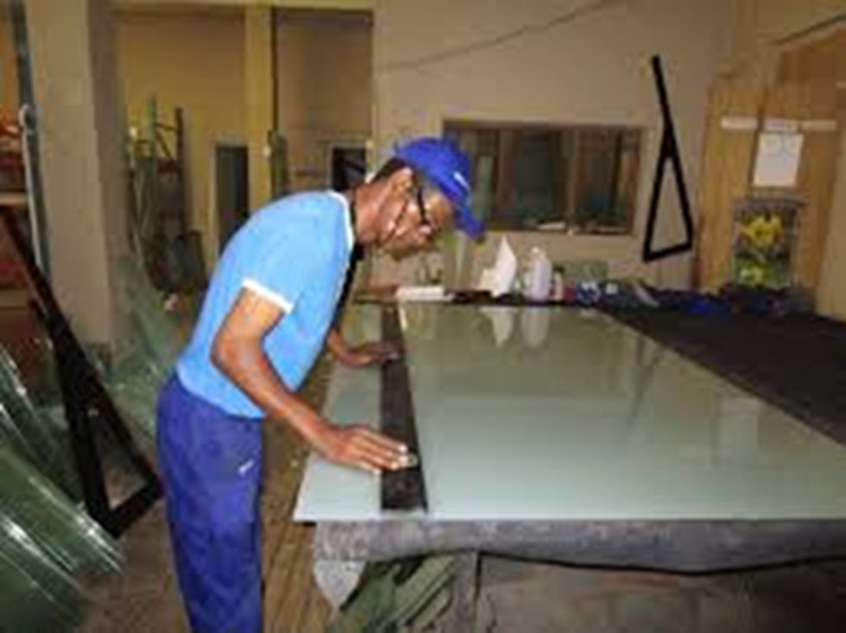
Glazing Maintenance
Video : Introduction to Glazing
https://youtu.be/AKKfW10Ygss?si=zZfbKo8h14MA4gjX

Slide 2
Glazing Maintenance
Safety rules in the workshop.
1. Carry glass to your side with two hands.
2. Never carry glass under your arm or above your head.
3. Always use two team members to move a large sheet of glass.
4. Use proper hand and body position.
5. Replace worn safety equipment before a job.
6. Do not stand and walk on broken glass.
7. Never break glass into smaller pieces with your foot and hand.
8. Do not hold on broken glass or try to stop falling glass.
9. Do not reach or catch glass by the corner of the lite.
10. Always be aware of your surrounding and the other team members.
11. Inspect containers and glass before unpacking.
12. Ensure no team members are in the of glass movement.
13. Do not stand on cracks.
14. Ensure glass is strapped to rack before moving.
15. Observe strapping for wear and replace if necessary.
Video :
https://youtu.be/bYt0EJxkAto?si=qxskkvnJjeWmindR
Feedback : Activity

Slide 3
Kwa Thema Skills School
Subject : Maintenance Marks :10
Grade : Year 1 Time : 30 mins
Date : / / 2024
Question:1
1. State whether the following statements are True or False
1.1. Curry glass to your side with one hand. ________
1.2. Never carry glass under your arm or above your head. ________
1.3. Always use two team members to move a large sheet of glass. ________
1.4. Do not use proper hand and body position. ________
1.5. Replace worn safety equipment before a job. _________
1.6. Do not stand and walk on broken glass. ________
1.7. Never break glass into smaller pieces with your foot and hand. ________
1.8. Hold on broken glass or try to stop falling glass. _________
1.9. Do not reach or catch glass by the corner of the lite. ________
1.10. Always be aware of your surrounding and the other team members. _________
(10)

